Slide 1

Introduction to Supervised Machine Learning
Soumya Banerjee
Notes:
negatvive microbiome periphery clinical infectious disease intra-cellular modelling, bioinformatics, data science

Slide 2
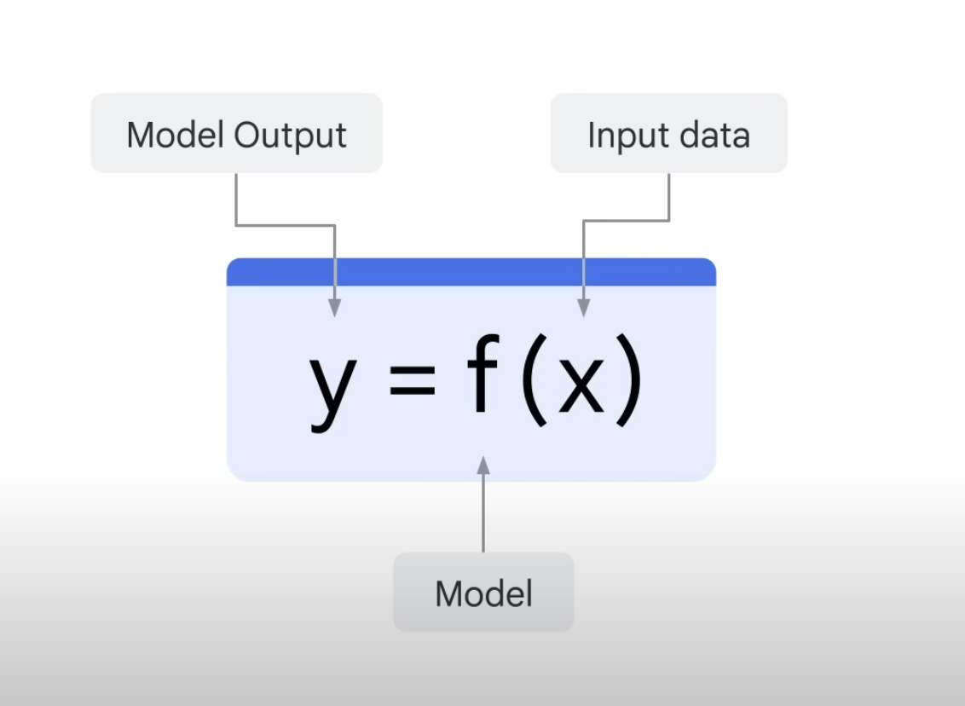
Supervised learning

Slide 3
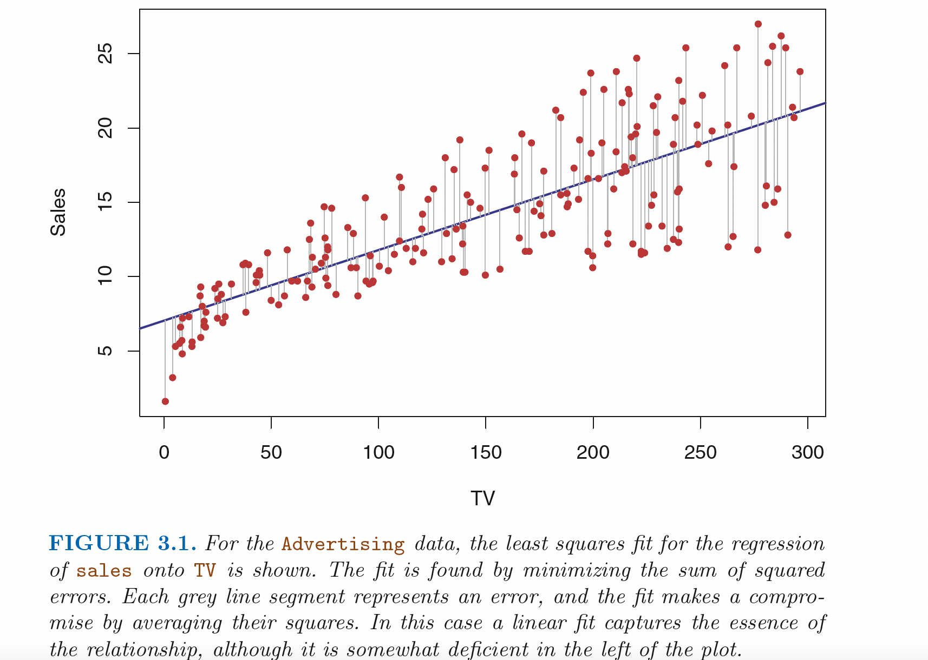
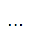
Linear regression
Notes:
I pick those which are consistent
From
~/periphery_project/bioinformatics/microarray_holm_il23/maplot_limma_pbmc_microarray_nick_RAWDATA_REANALYZED_samepatient_onedonorexcluded_usingpca_ALLPROBES_generic_ggrepel.pdf
generated from R ~/periphery_project/bioinformatics/microarray_holm_il23/holm_pbmc_microarray_limma_onedonorexcluded_usingpca_generic.rmd% (re-analyzed from raw data)% plots in right direction (flipped signs), with ggrepel and plots with max probes% plots publication ready plots

Slide 4
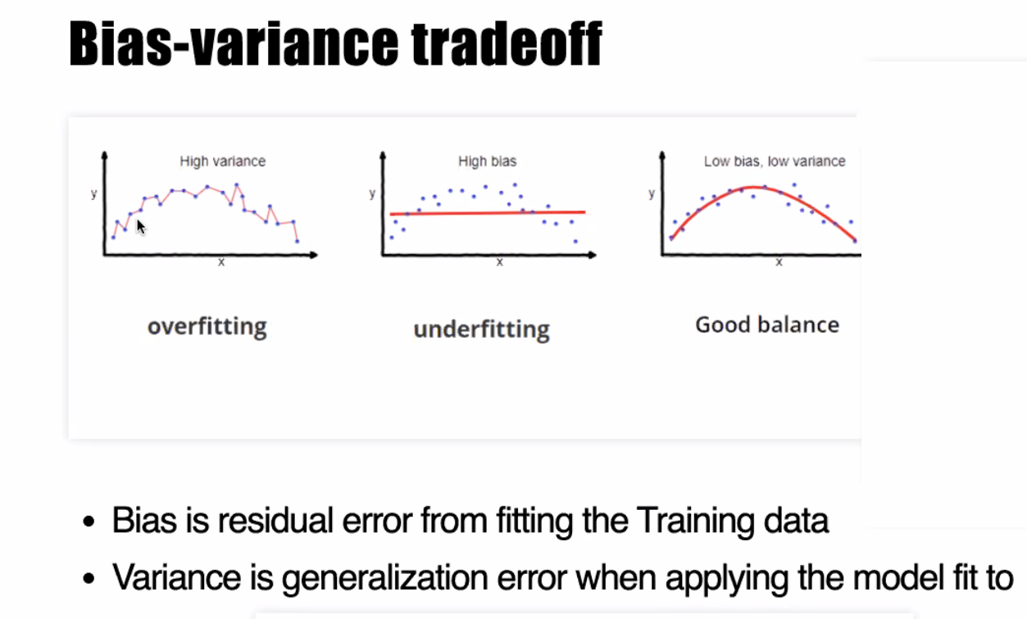
A fundamental concept in machine learning

Slide 5
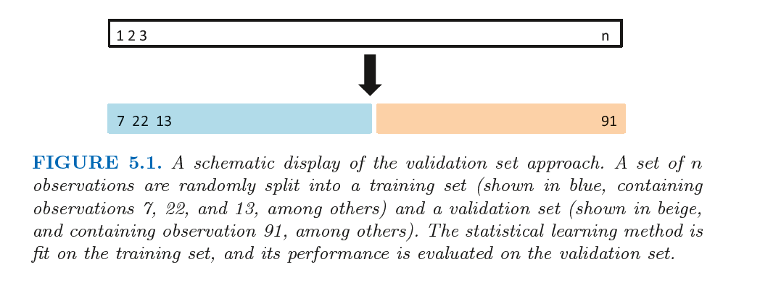
A fundamental concept in machine learning
An Introduction to Statistical Learning with Applications in R

Slide 6
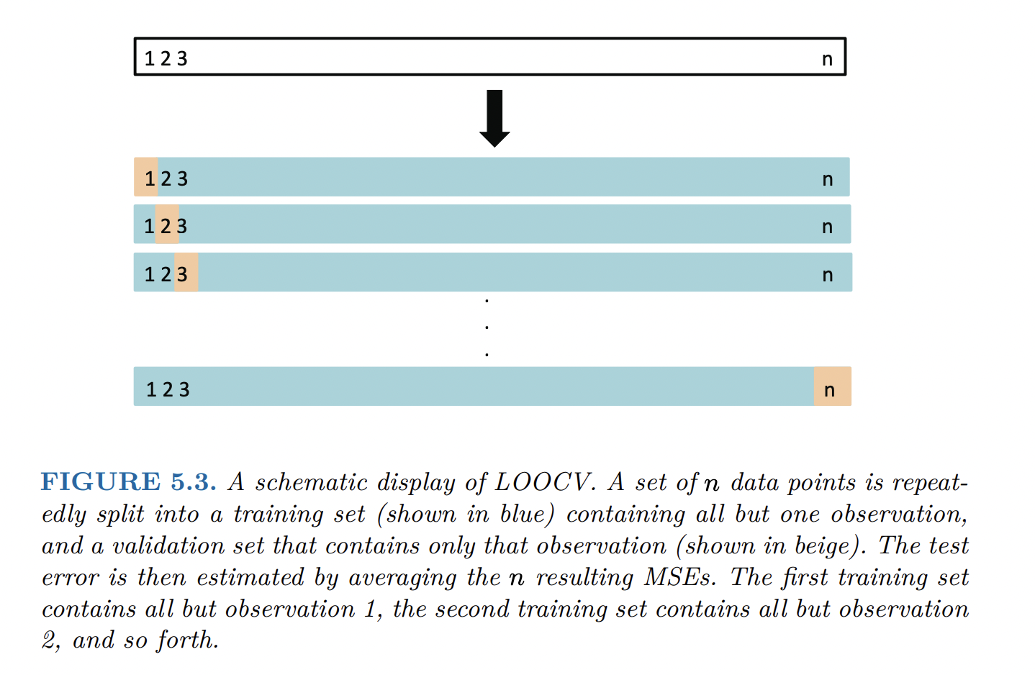
Leave one out cross-validation
An Introduction to Statistical Learning with Applications in R

Slide 7
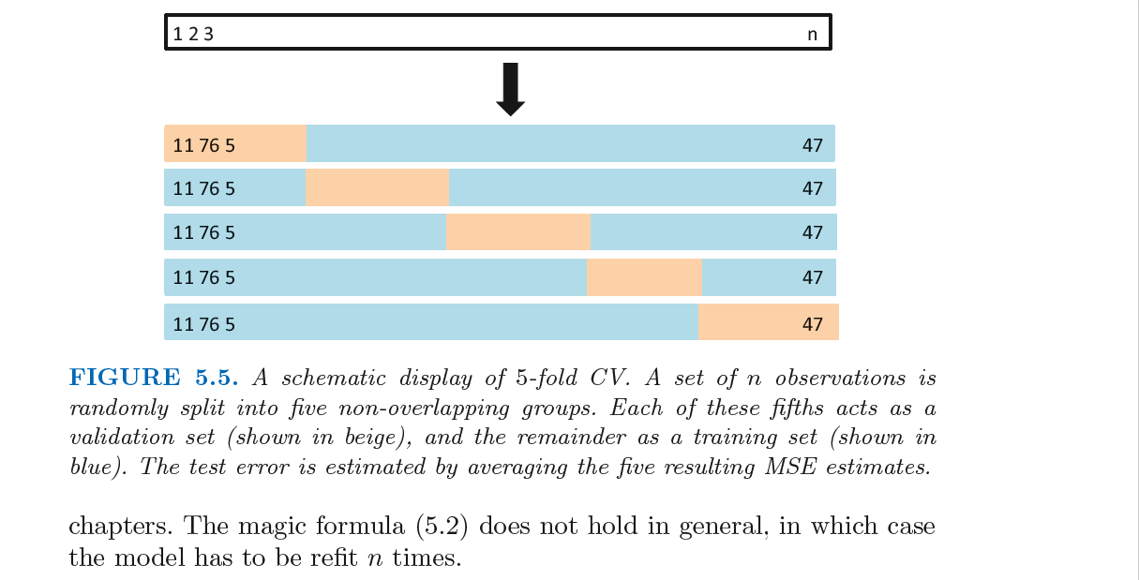
K-fold cross-validation
An Introduction to Statistical Learning with Applications in R

Slide 8
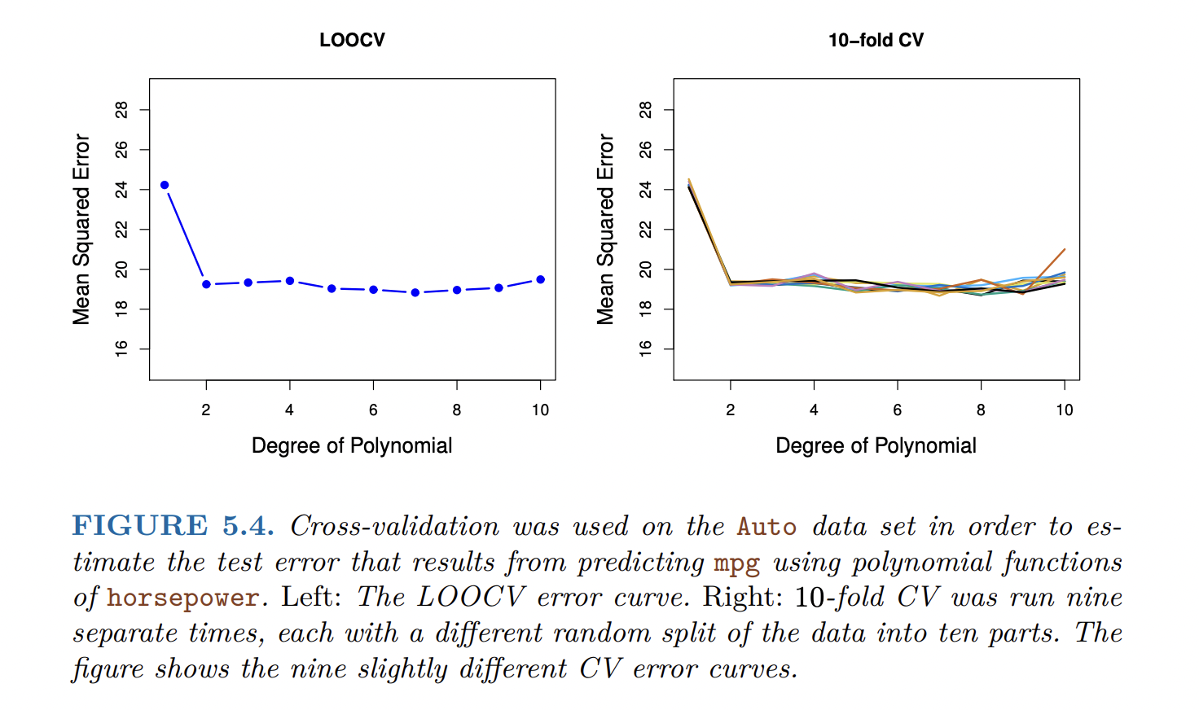
Cross-validation
An Introduction to Statistical Learning with Applications in R

Slide 9
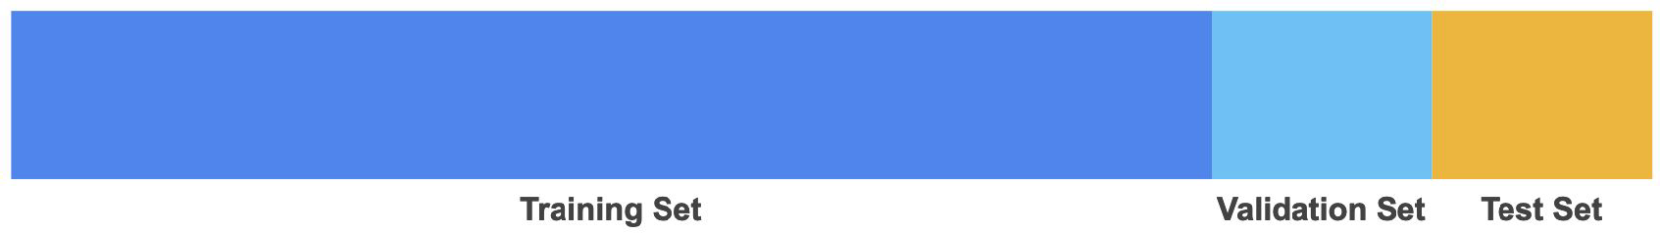
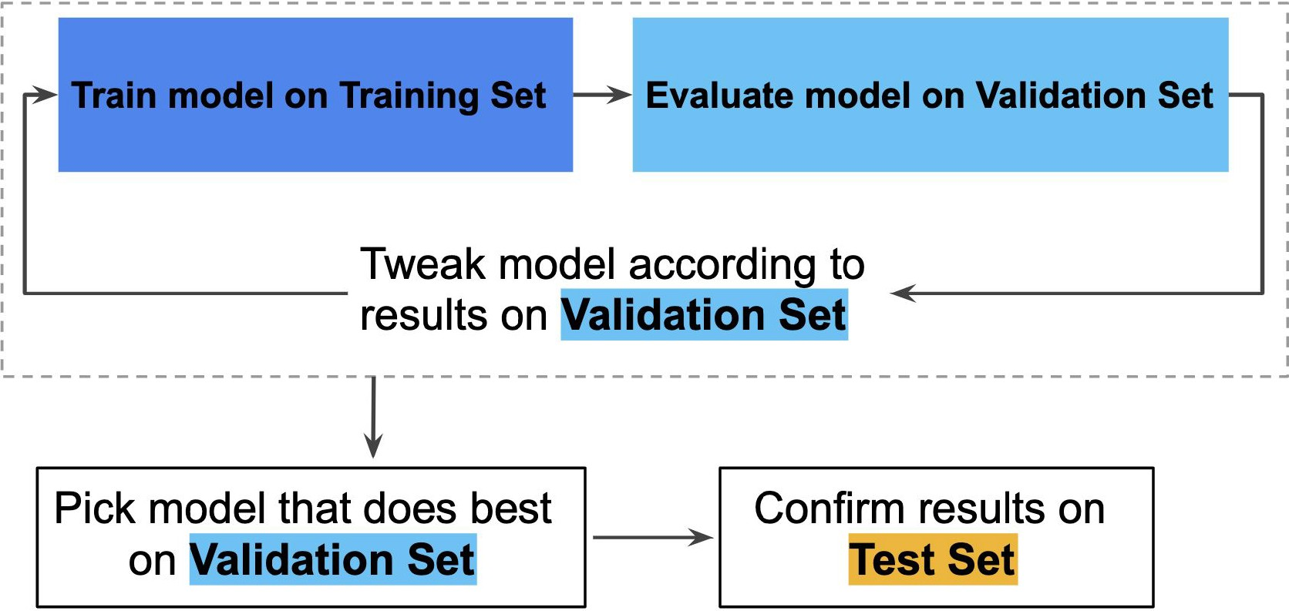
Partitioning the data
Slide courtesy Irina Mohorianu

Slide 10
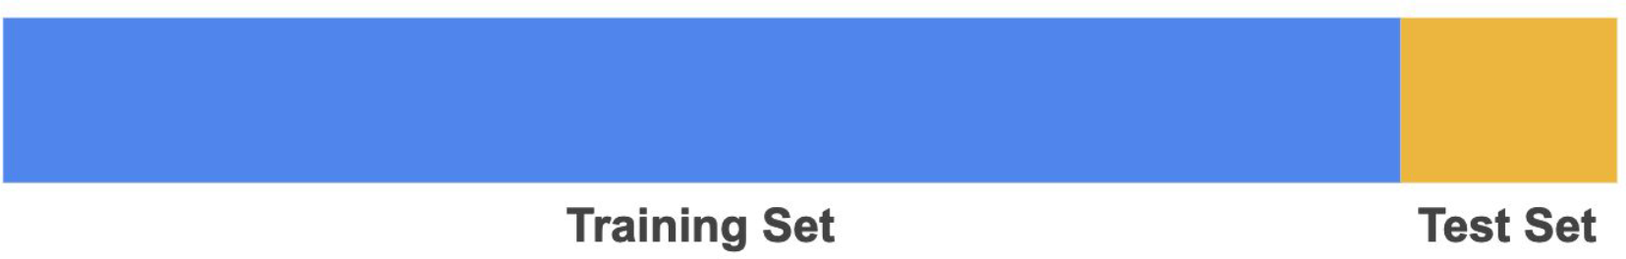
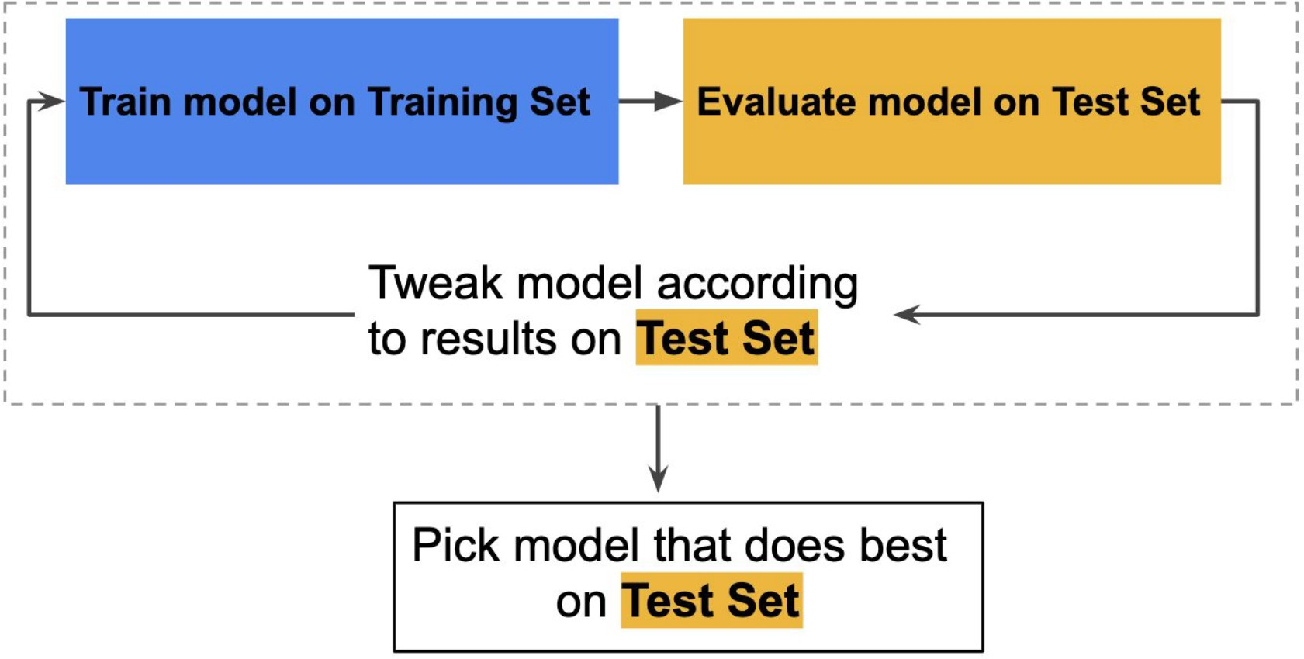
Partitioning the data (WRONG)
Problem:
Overfitting on the Test dataset
Slide courtesy Irina Mohorianu

Slide 11
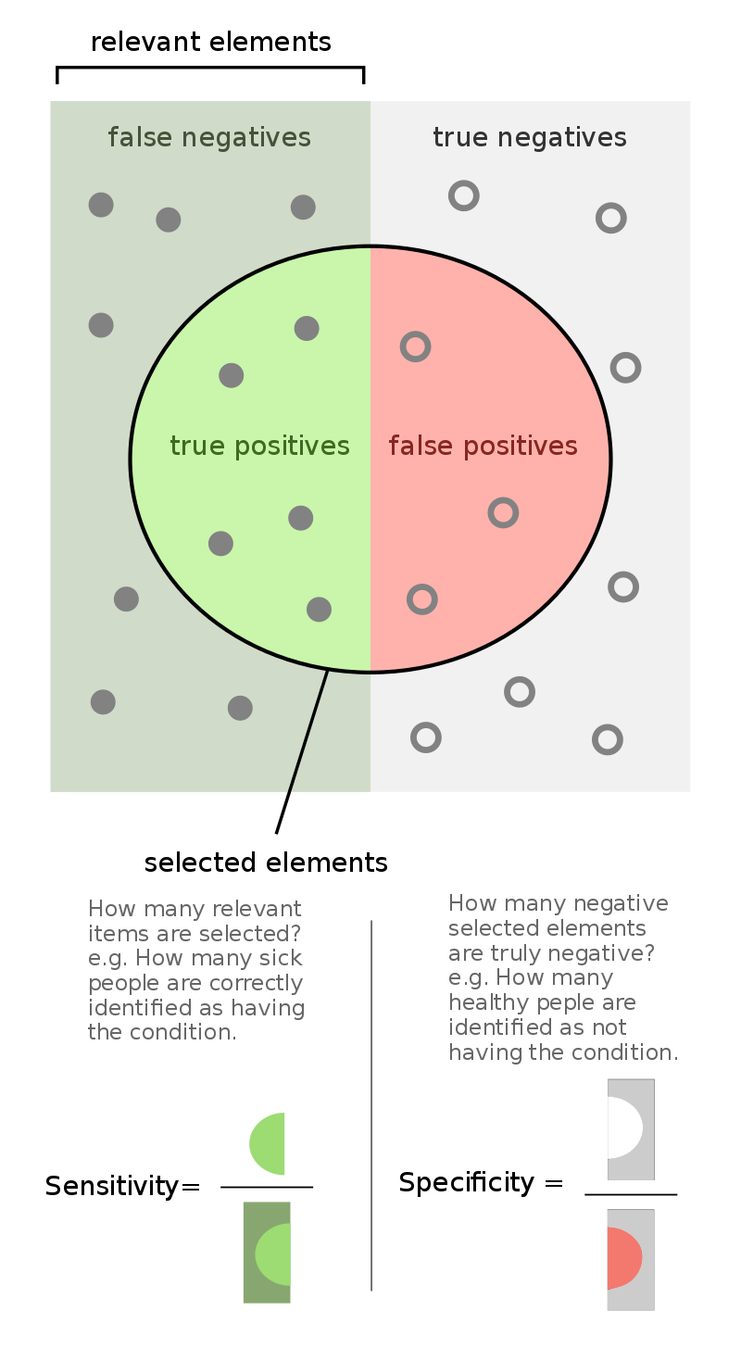
Hypothesis
West et al., Nature Medicine, 2017
Notes:
What happens if we use a simple classifier that just predicts randomly on a disease? For example, say you are trying to predict a particular disease. Each person has for each person. Assume you have features like age, gender and medications. You have to predict whether this patient will get a disease or not. As even the disease occurs in 90% of the population. How should you build your algorithm? What metric should you look at?
Answer: You should look at class-specific error (sensitivity/specificity). This is unbalanced data. Even an algorithm that randomly outputs 1 that is the person has disease, regardless of the input features, would give a 90% accuracy on the data.

Slide 12
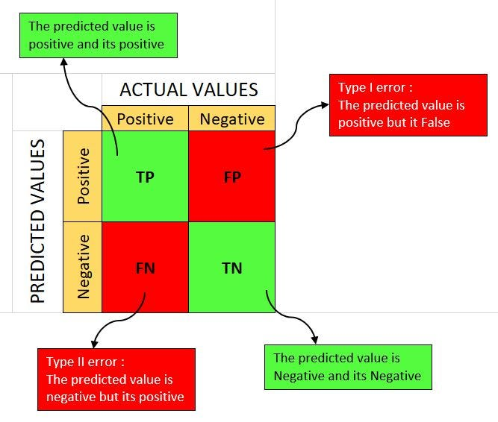
Confusion matrix
West et al., Nature Medicine, 2017

Slide 13
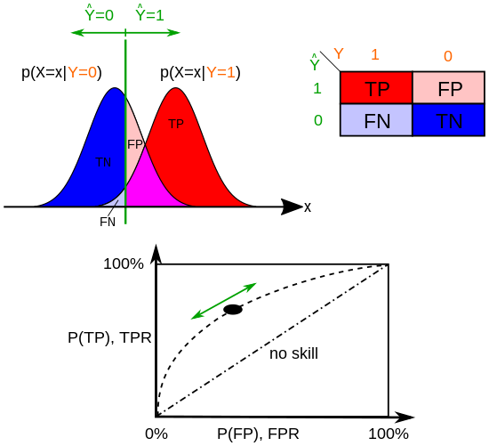
Hypothesis
The probability of a Type 1 error is the significance level (0.05)
https://en.wikipedia.org/wiki/Type_I_and_type_II_errors

Slide 14
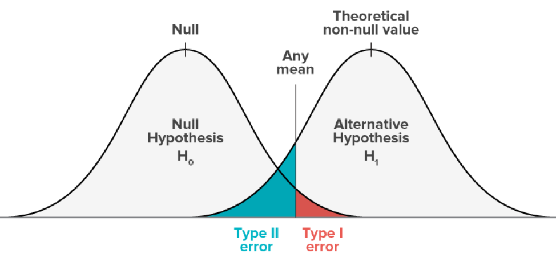
Hypothesis
The probability of a Type 1 error is the significance level (0.05)
https://www.abtasty.com/blog/type-1-and-type-2-errors/

Slide 15
Question
What happens if we use a simple classifier that just predicts randomly on a disease?
For example, say you are trying to predict a particular disease.
Assume you have features like age, gender and medications.
You have to predict whether this patient will get a disease or not.
Assume the disease occurs in 90% of the population.
How should you build your algorithm? What metric should you look at?
Notes:
What happens if we use a simple classifier that just predicts randomly on a disease? For example, say you are trying to predict a particular disease. Each person has for each person. Assume you have features like age, gender and medications. You have to predict whether this patient will get a disease or not. As even the disease occurs in 90% of the population. How should you build your algorithm? What metric should you look at?
Answer: You should look at class-specific error (sensitivity/specificity). This is unbalanced data. Even an algorithm that randomly outputs 1 that is the person has disease, regardless of the input features, would give a 90% accuracy on the data.

Slide 16
Question
What happens if we use a simple classifier that just predicts randomly on a disease?
For example, say you are trying to predict a particular disease.
Assume you have features like age, gender and medications.
You have to predict whether this patient will get a disease or not.
Assume the disease occurs in 90% of the population.
How should you build your algorithm? What metric should you look at?
Answer: You should look at class-specific error (sensitivity/specificity).
a. This is unbalanced data.
b. Even an algorithm that randomly outputs 1 [the person has disease], (regardless of the input features), would give 90% accuracy on the data.
Notes:
What happens if we use a simple classifier that just predicts randomly on a disease? For example, say you are trying to predict a particular disease. Each person has for each person. Assume you have features like age, gender and medications. You have to predict whether this patient will get a disease or not. As even the disease occurs in 90% of the population. How should you build your algorithm? What metric should you look at?
Answer: You should look at class-specific error (sensitivity/specificity). This is unbalanced data. Even an algorithm that randomly outputs 1 that is the person has disease, regardless of the input features, would give a 90% accuracy on the data.

Slide 17

Decision Trees
How to pack groceries?
Tomatoes, soft vegetables
Wine, fragile items
Bread
Toiletries, shampoo
Meat, fish

Slide 18
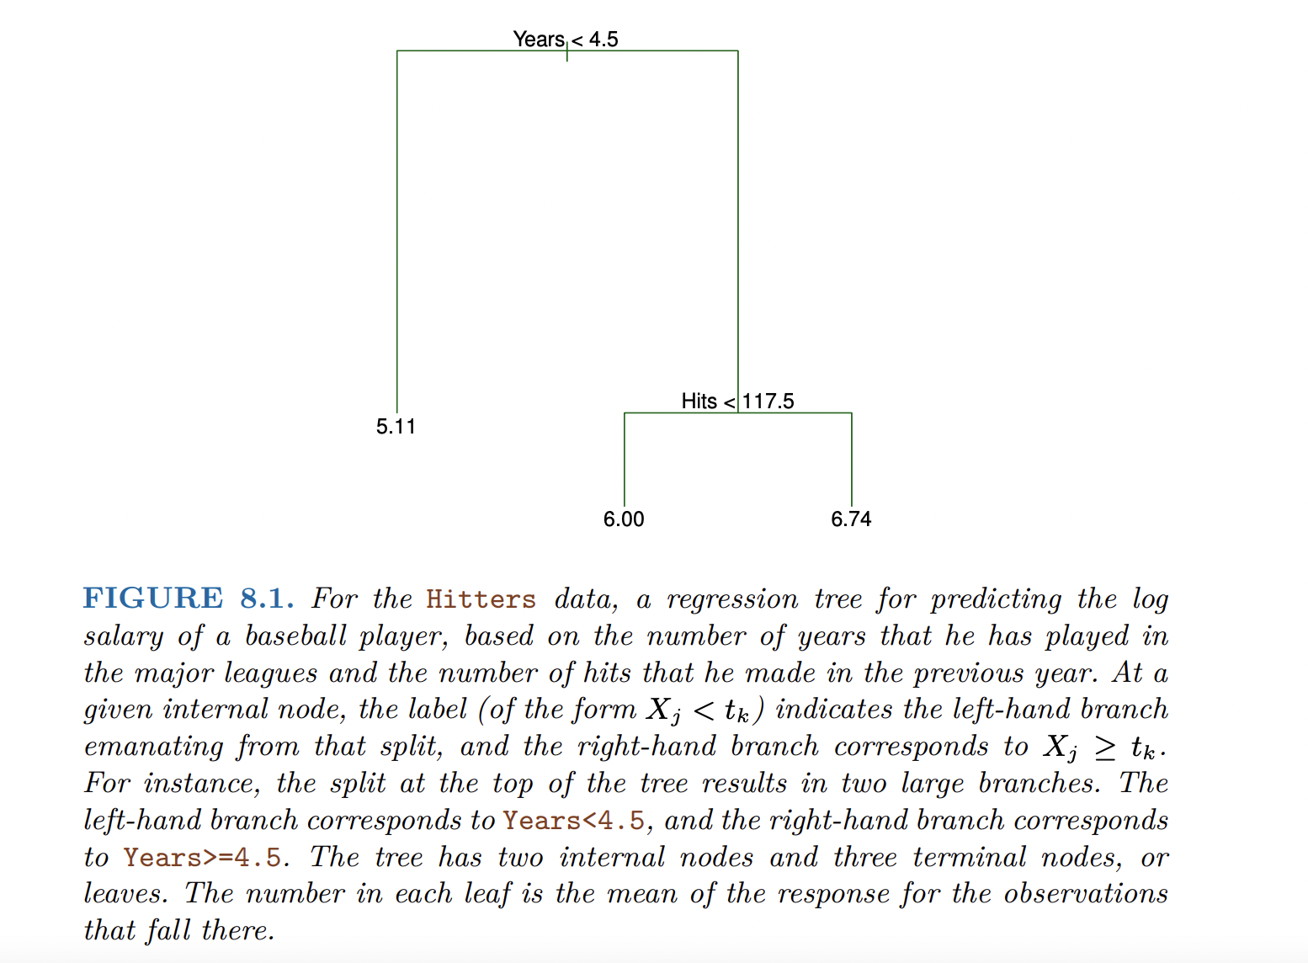
Decision Trees
Notes:
Years is the most important feature (and previous hits does not matter that much)

Slide 19
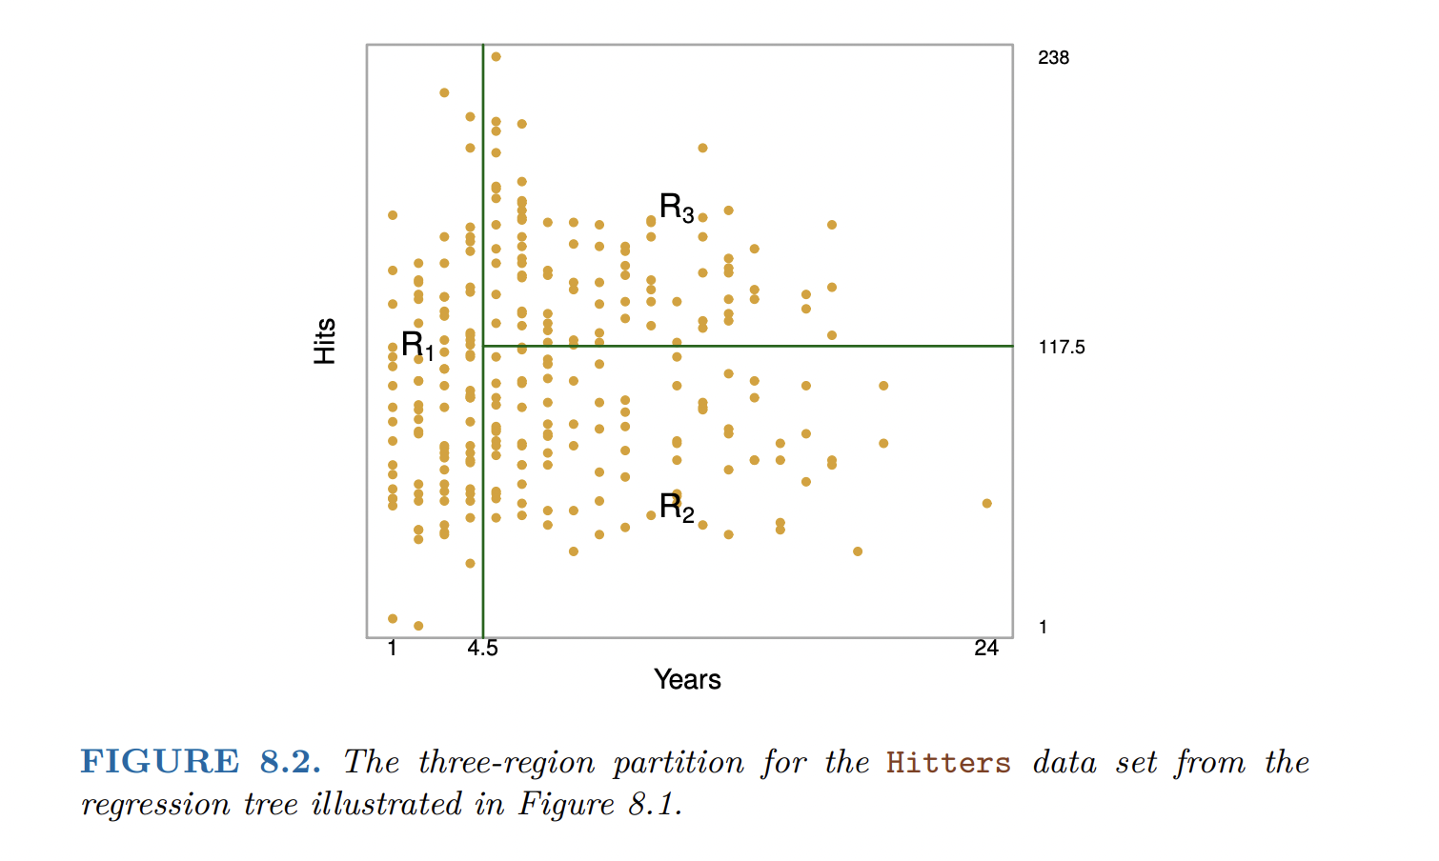
Decision Trees
An Introduction to Statistical Learning with Applications in R

Slide 20
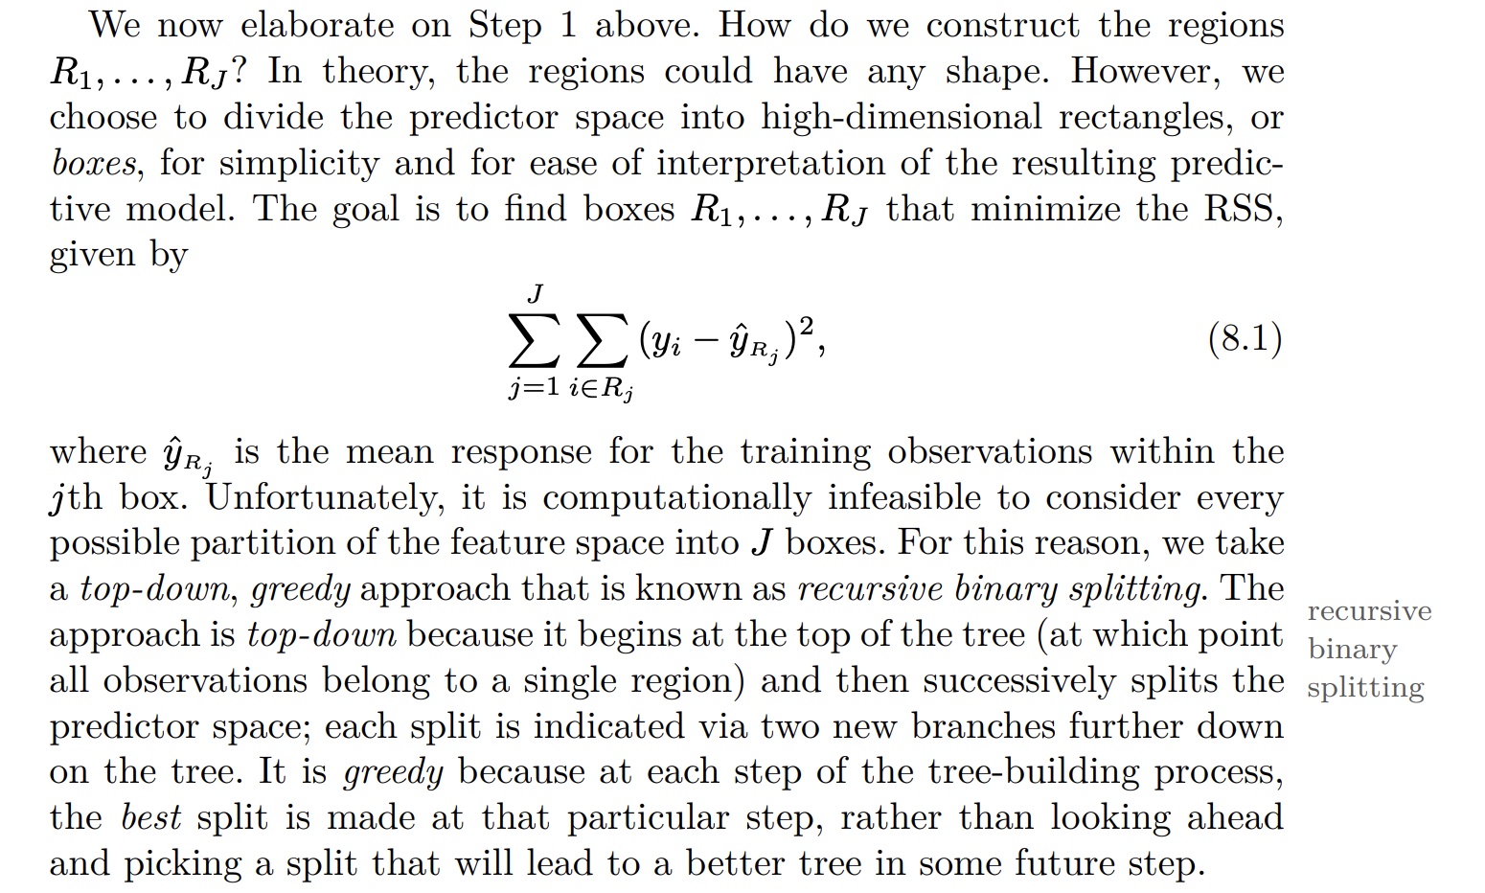
Decision Trees

Slide 21
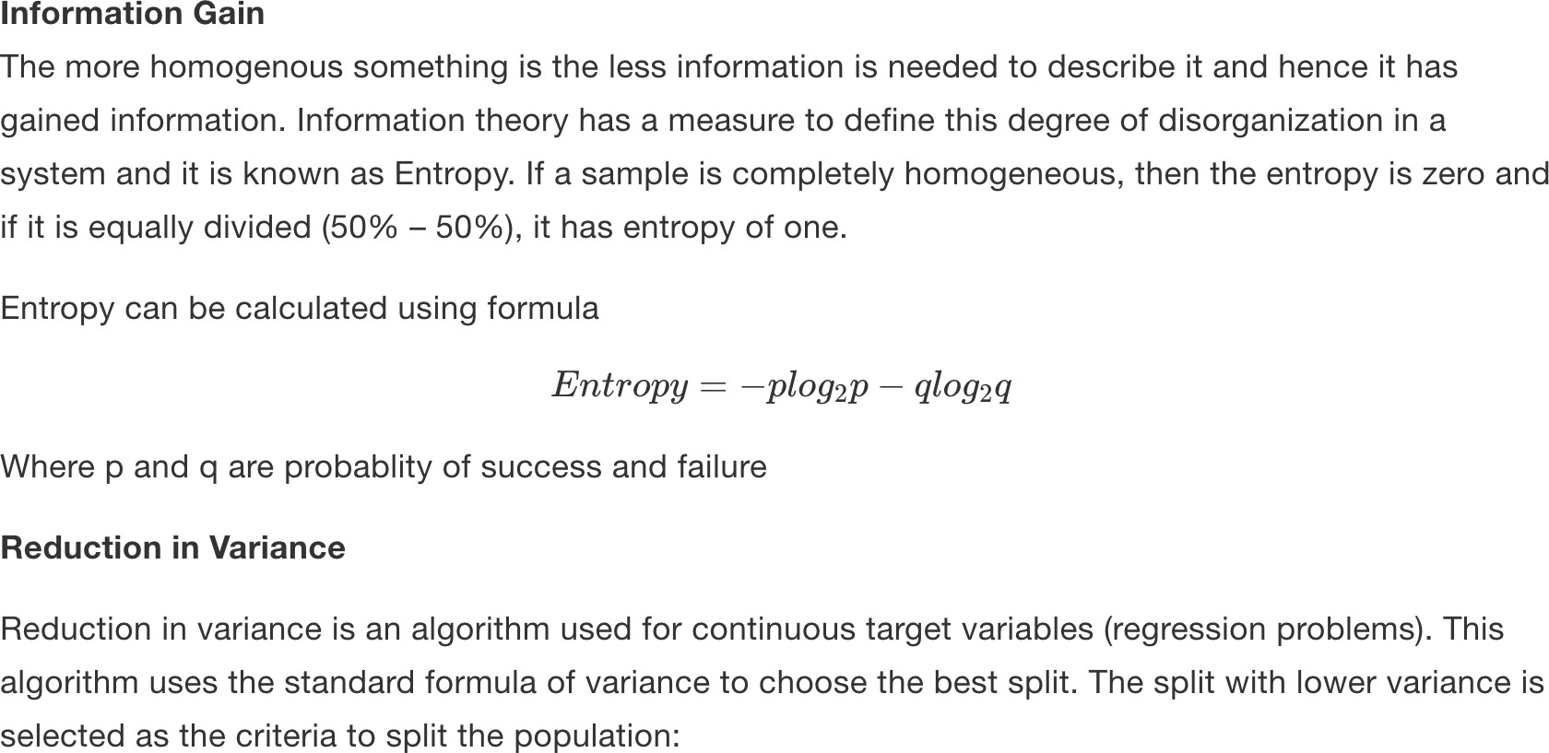
Decision Trees. Splitting decision

Slide 22
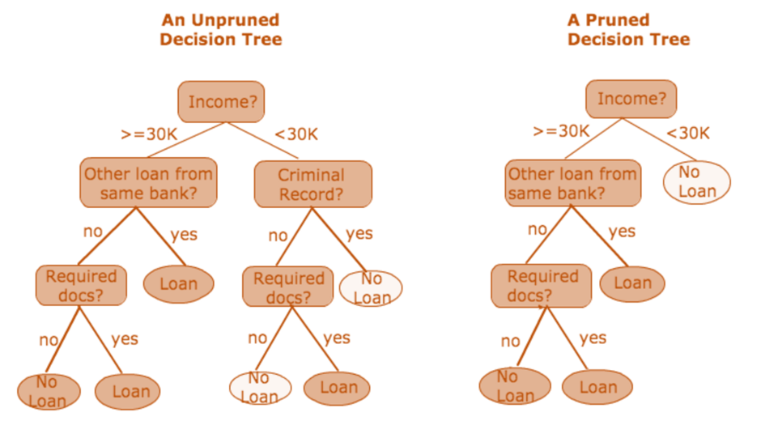
Decision Trees: how to get smaller trees
https://medium.com/@ompramod9921/decision-trees-8e2391f93fa7

Slide 23
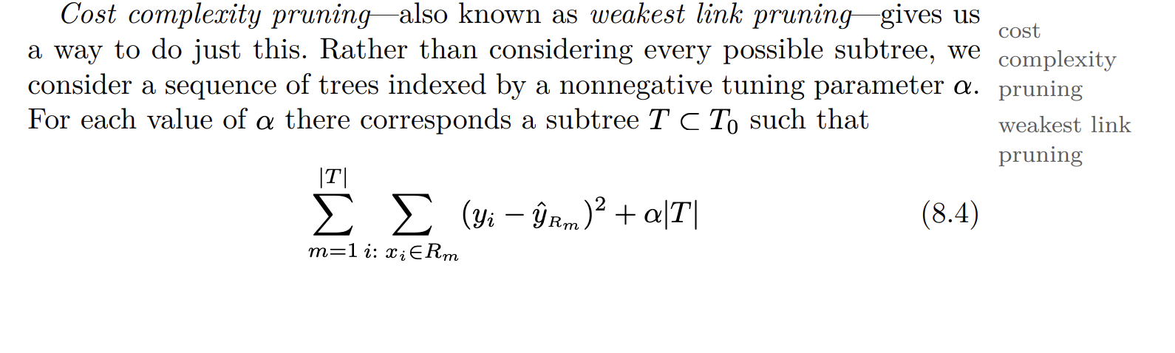
Decision Trees: how to get smaller trees
An Introduction to Statistical Learning with Applications in R

Slide 24
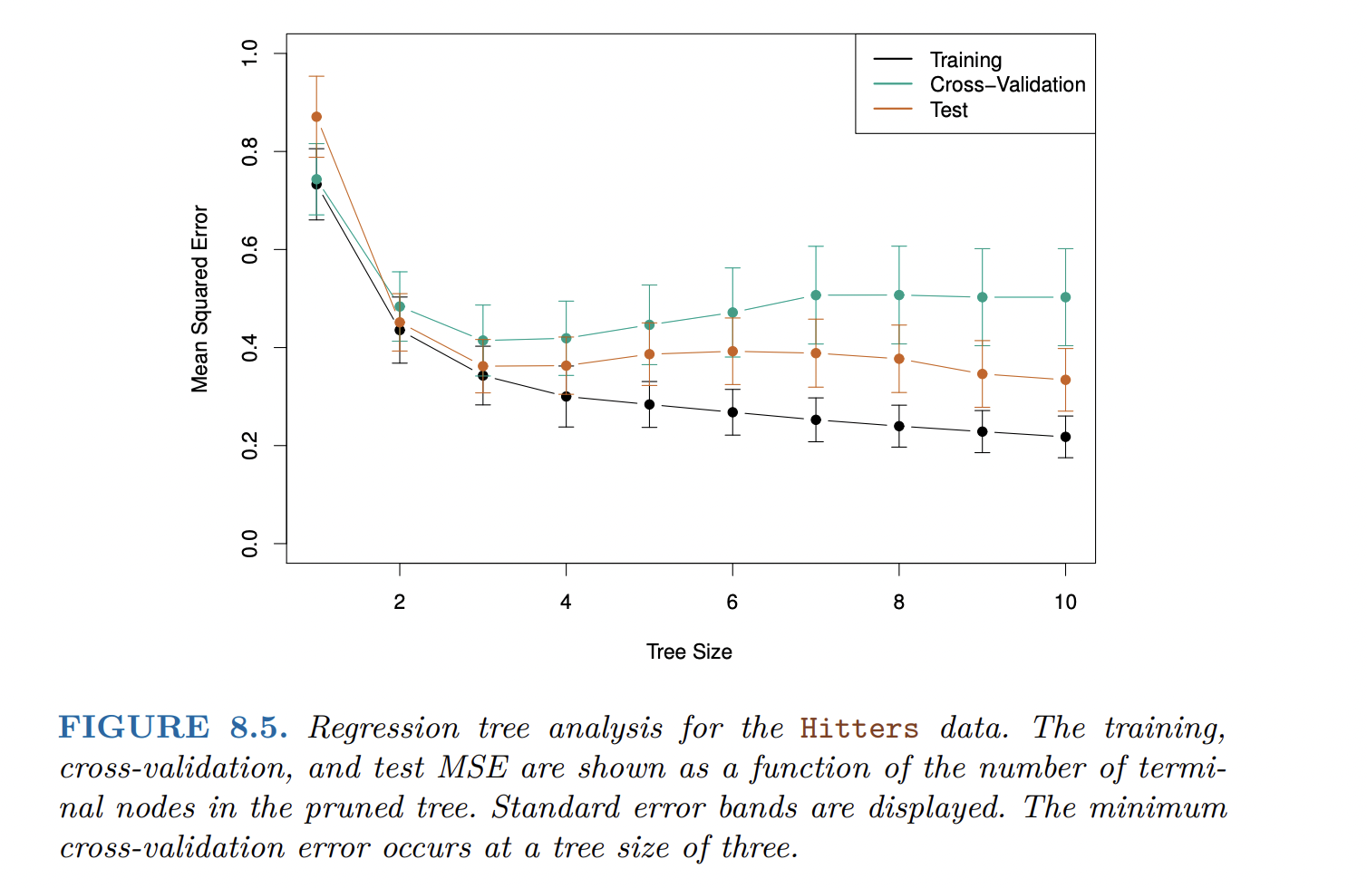
Decision Trees

Slide 25
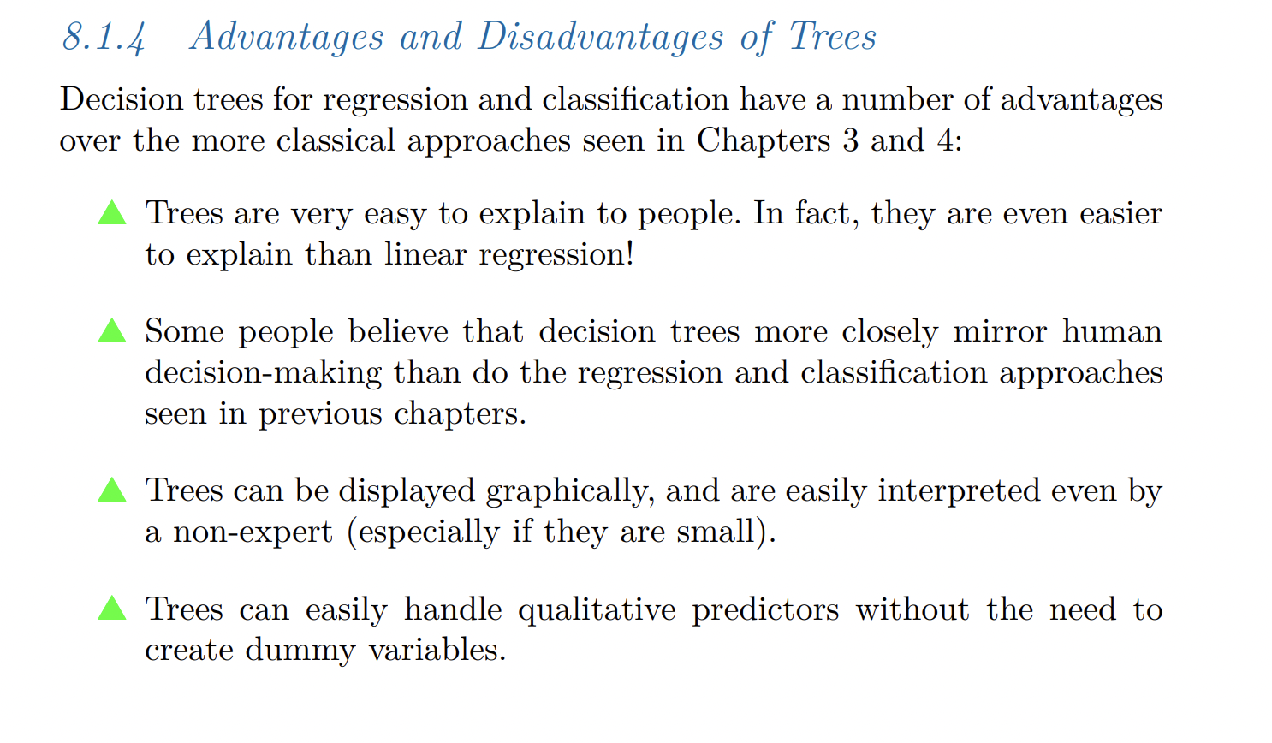
Pros and cons of trees
An Introduction to Statistical Learning with Applications in R

Slide 26
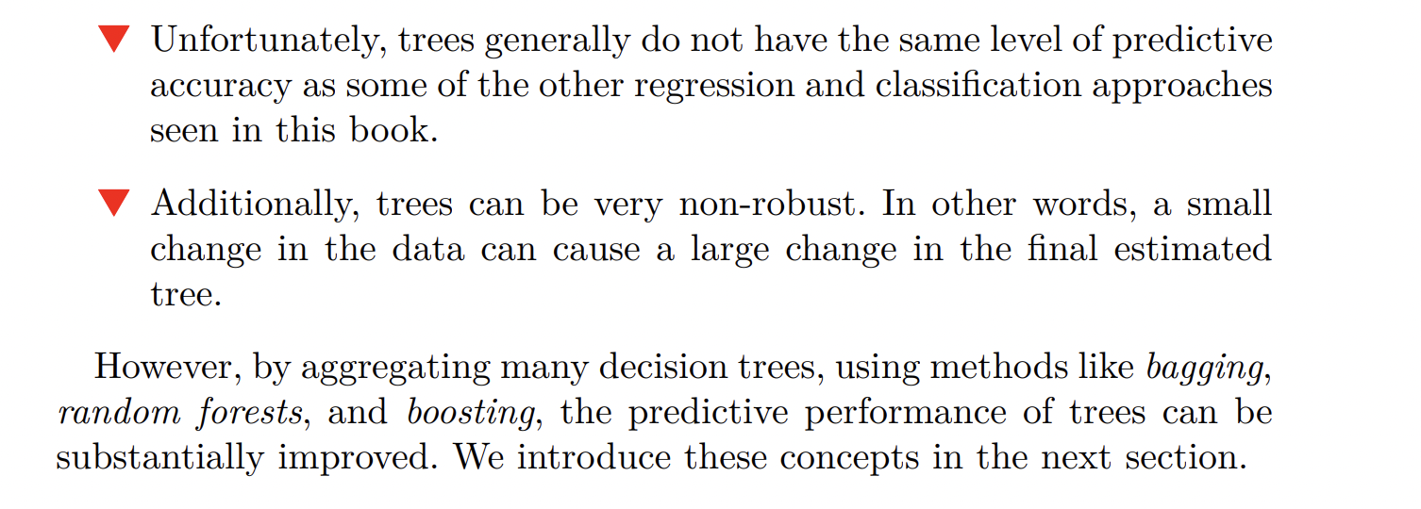
Pros and cons of trees
An Introduction to Statistical Learning with Applications in R

Slide 27
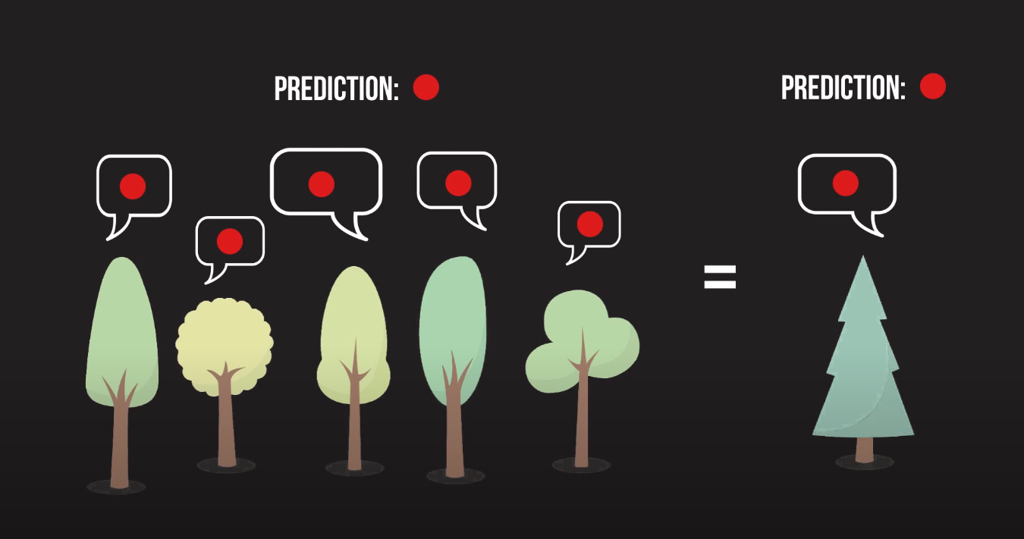
Random Forests
https://towardsdatascience.com/a-visual-guide-to-random-forests-b3965f453135

Slide 28
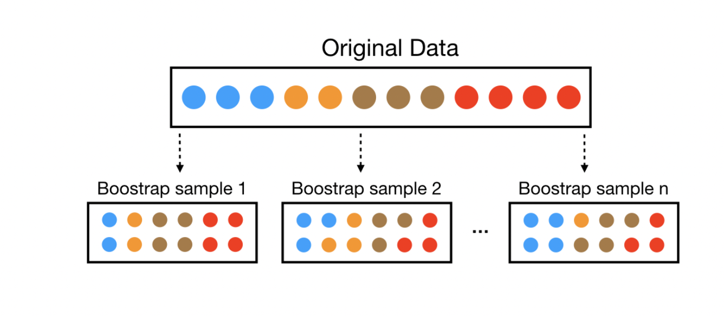
Bagging
https://bradleyboehmke.github.io/random-forest-training/slides-source.html#33

Slide 29
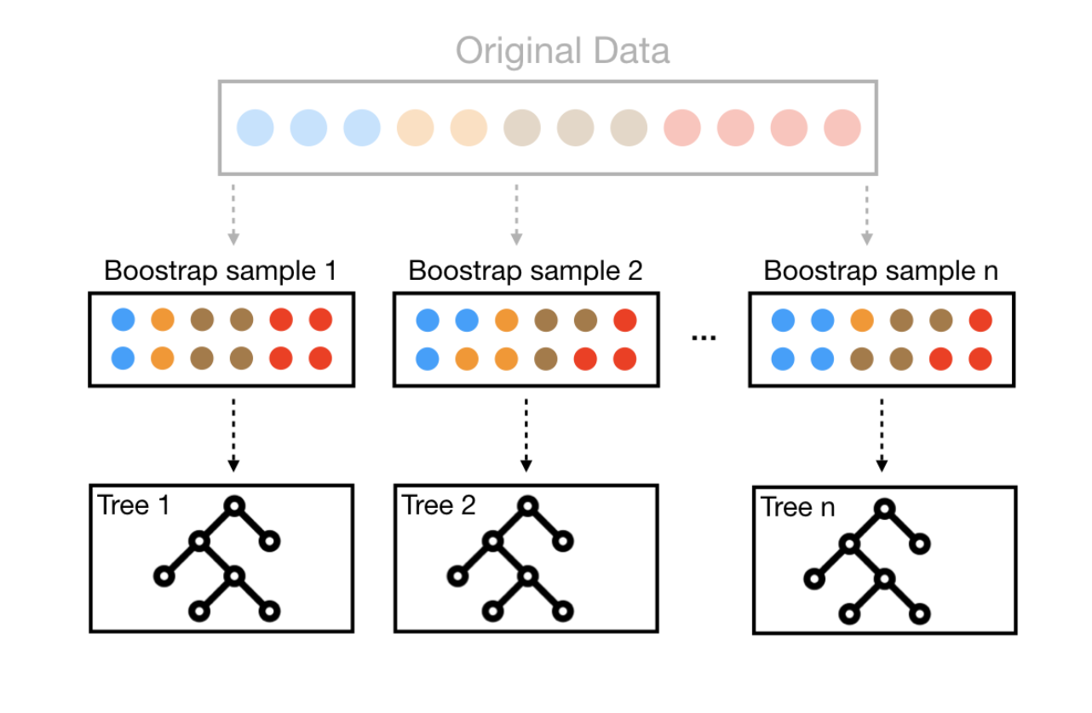
Bagging
https://bradleyboehmke.github.io/random-forest-training/slides-source.html#33

Slide 30
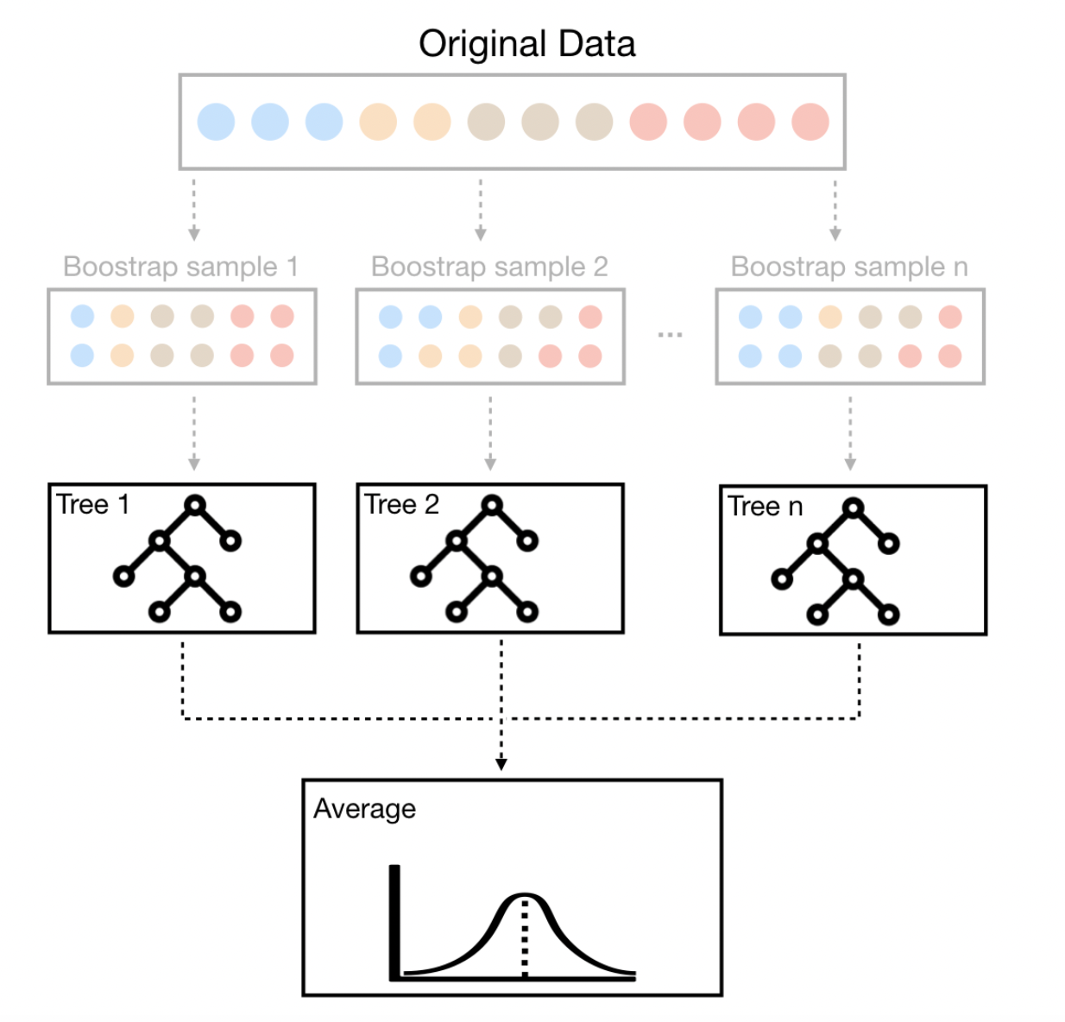
Bagging
1. How would you cross-validate?
2. Can this lead to any problems?

Slide 31
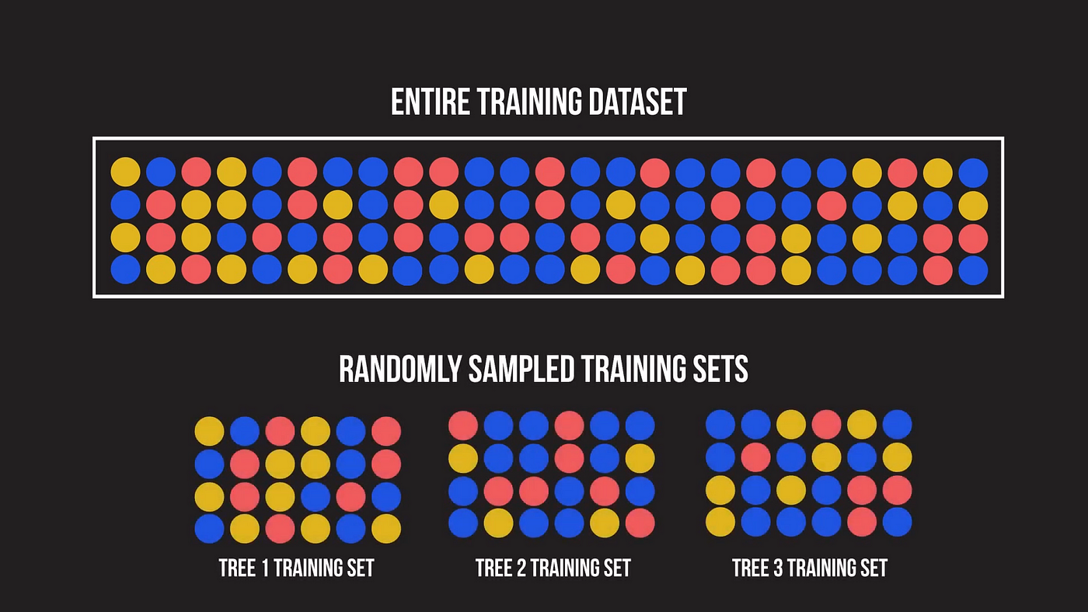
Correlated trees
https://towardsdatascience.com/a-visual-guide-to-random-forests-b3965f453135

Slide 32
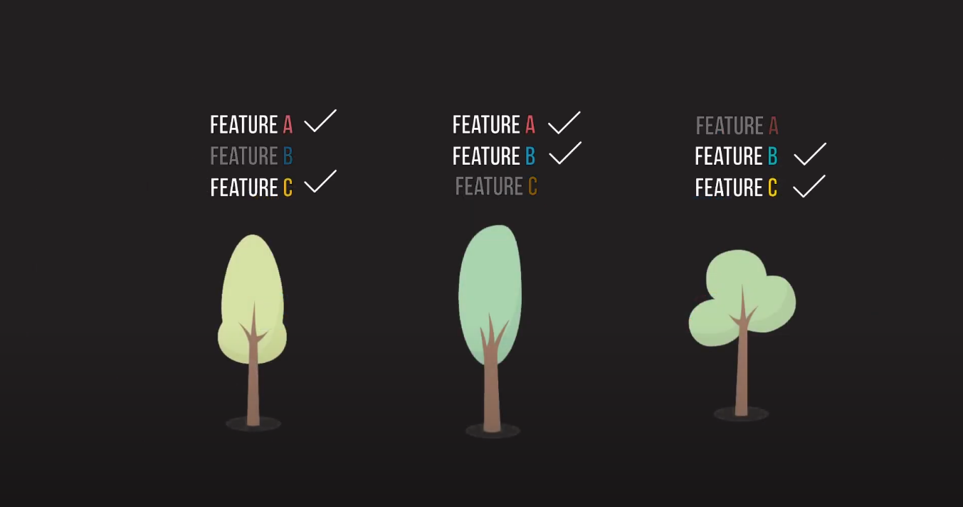
Solution
https://towardsdatascience.com/a-visual-guide-to-random-forests-b3965f453135

Slide 33
Random forests + Bagging
Decorrelate trees
When deciding on a split, a random sample of features is taken
Each tree is built on a different random sample of features!

Slide 34
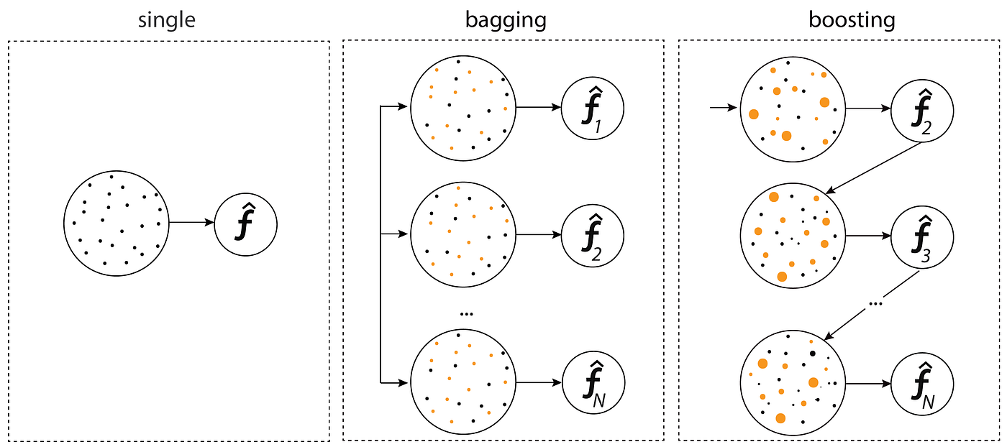
Bagging and Boosting
https://medium.com/@senozanAleyna/ensemble-boosting-bagging-and-stacking-machine-learning-6a09c31df778
Notes:
Why bagging may lead to problems

Slide 35
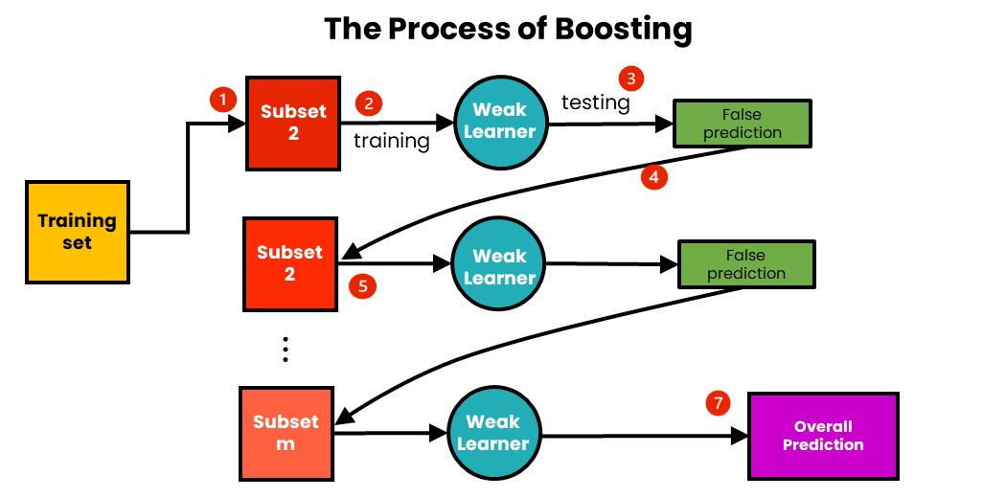
Boosting
https://medium.com/@brijesh_soni/understanding-boosting-in-machine-learning-a-comprehensive-guide-bdeaa1167a6
Notes:
Why bagging may lead to problems

Slide 36
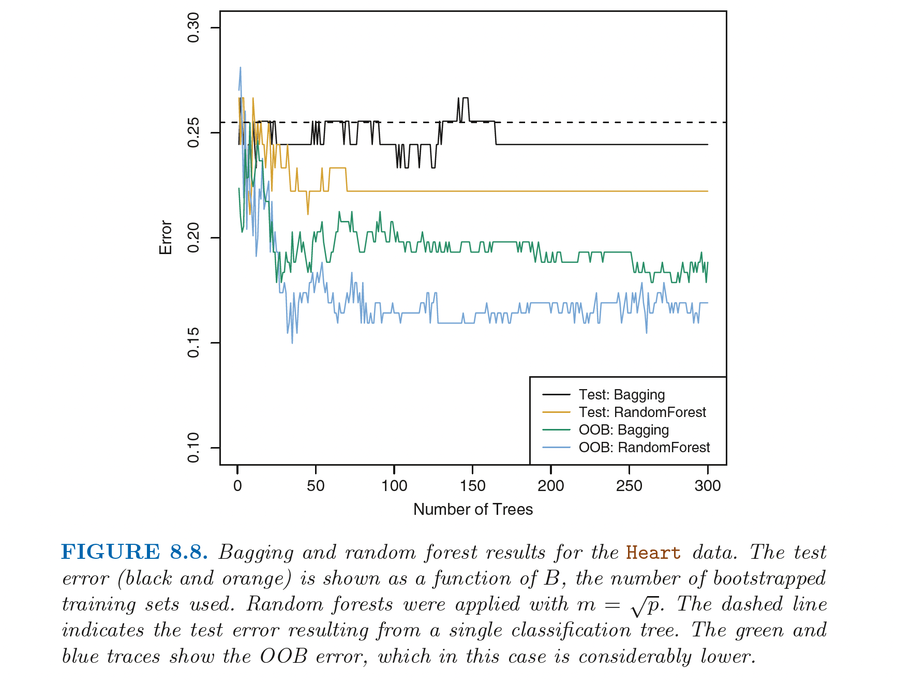
Random Forests (PRACTICAL)

Slide 37
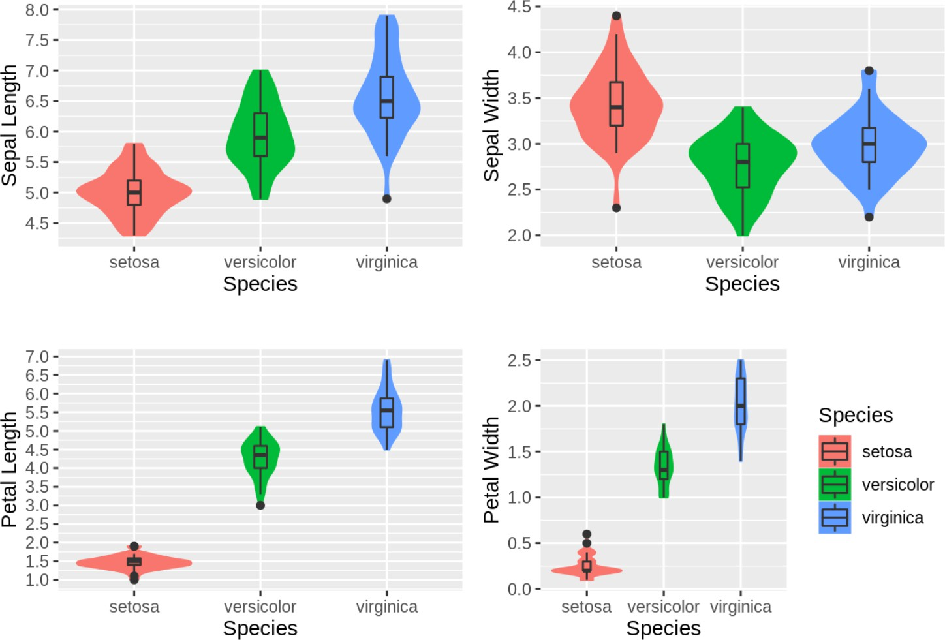
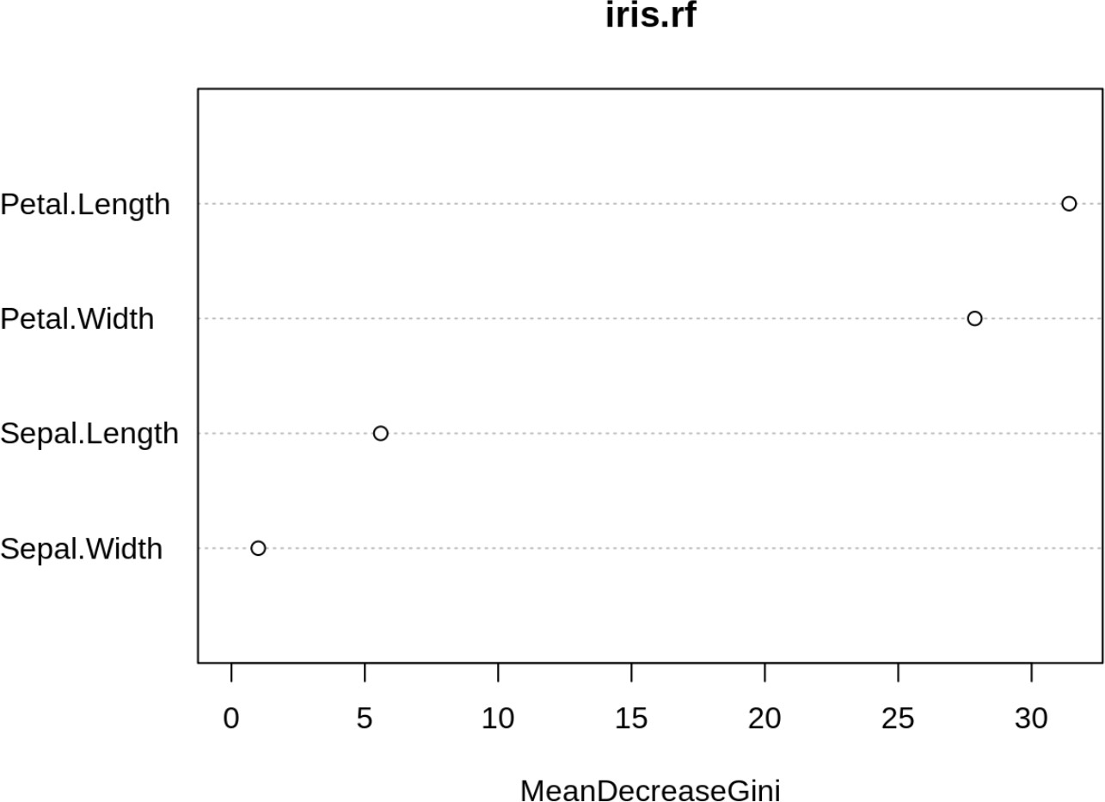
Random Forests: Variable Importance (PRACTICAL)
Slide courtesy Irina Mohorianu

Slide 38

Artificial Neural Networks
Iterated logistic regression
https://saedsayad.com/logistic_regression.htm

Slide 39
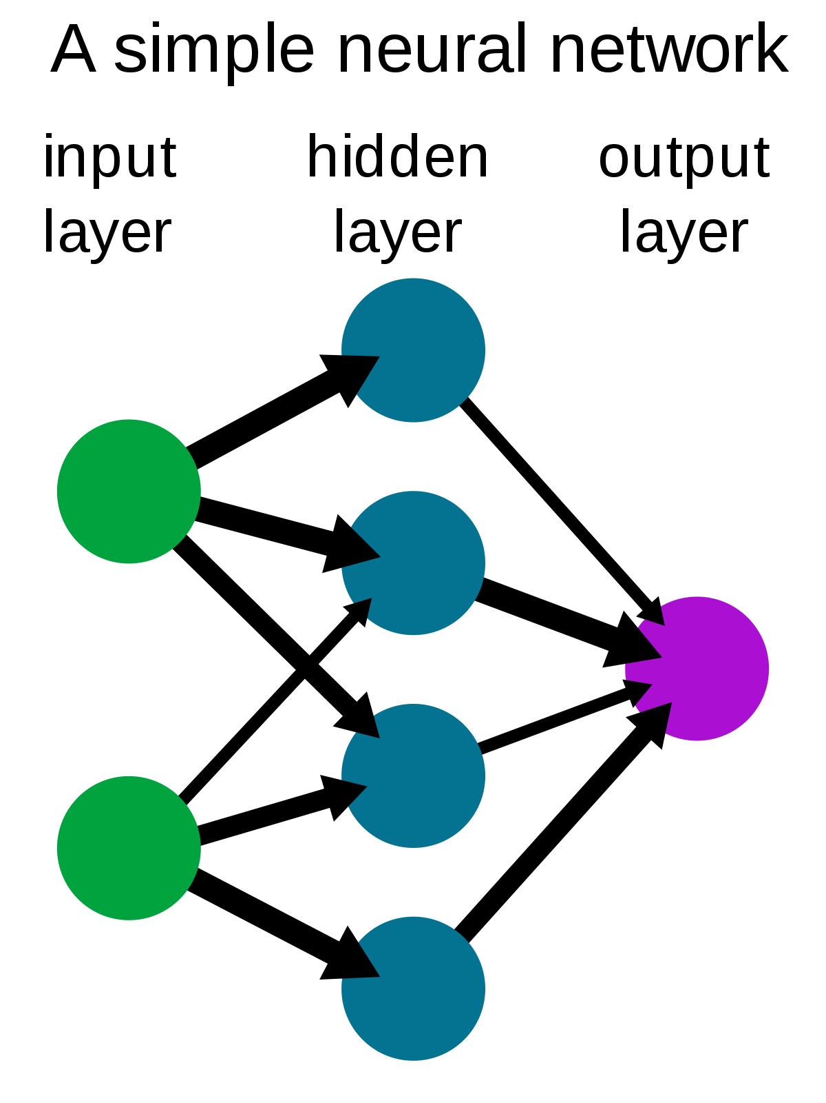
Artificial Neural Networks
Iterated logistic regression
https://en.wikipedia.org/wiki/Neural_network#/media/File:Neural_network_example.svg
Notes:
Link to deep neural nets and large language models

Slide 40
A fundamental concept in machine learning
Notes:
One thing I want you to memorize; please commit this to memory

Slide 41
A fundamental concept in machine learning
An Introduction to Statistical Learning with Applications in R

Slide 42
Hypothesis
West et al., Nature Medicine, 2017
Notes:
What happens if we use a simple classifier that just predicts randomly on a disease? For example, say you are trying to predict a particular disease. Each person has for each person. Assume you have features like age, gender and medications. You have to predict whether this patient will get a disease or not. As even the disease occurs in 90% of the population. How should you build your algorithm? What metric should you look at?
Answer: You should look at class-specific error (sensitivity/specificity). This is unbalanced data. Even an algorithm that randomly outputs 1 that is the person has disease, regardless of the input features, would give a 90% accuracy on the data.

Slide 43
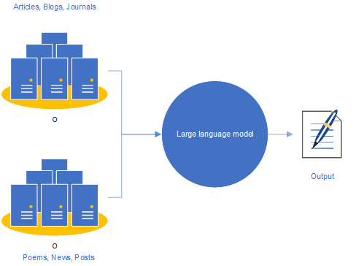
Applications of this concept
I saw a cat on a …
mat
https://becominghuman.ai/a-quick-introduction-to-the-large-language-model-chatgpt-a2f5f54b4d5e
Notes:
Say you are working in a startup and you have created a new model …… gizillions of parameters and less data. How would you …..

Slide 44
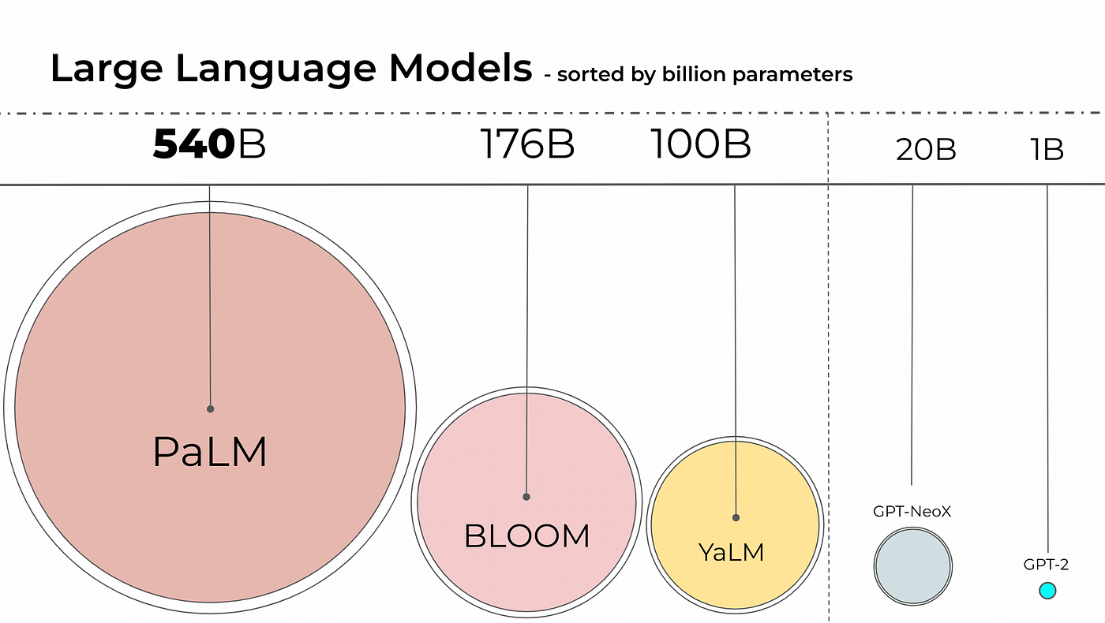
Applications of this concept
https://ashukumar27.medium.com/decoding-large-language-models-quantization-ff58964c0f31

Slide 45
Resources
Code, practicals and talk (recorded)
https://github.com/neelsoumya/public_supervised_machine_learning
https://github.com/neelsoumya/practical_supervised_machine_learning
Free PDF of book and R code
https://www.statlearning.com/resources-second-edition
More practical tutorials and R code
https://cambiotraining.github.io/intro-machine-learning/

Slide 46
Questions

